Slide 1

Flutter

Slide 2
Flutter
StatefulWidget
Counter
Image

Slide 3

StatelessWidget
import 'package:flutter/material.dart';
class CounterExample extends StatelessWidget {
@override
Widget build(BuildContext context) {
return Scaffold(
backgroundColor: Colors.orange,
);
}
}

Slide 4
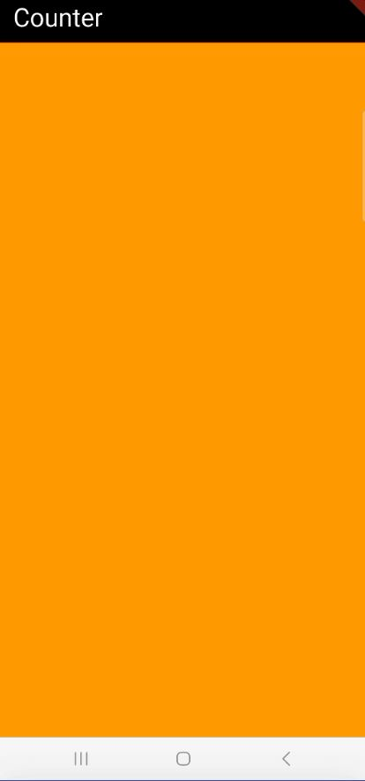
StatelessWidget
import 'package:flutter/material.dart';
class CounterExample extends StatelessWidget {
@override
Widget build(BuildContext context) {
return Scaffold(
backgroundColor: Colors.orange,
appBar: AppBar(title: Text('Counter',style: TextStyle(color: Colors.white),),backgroundColor: Colors.black,),
);
}
}

Slide 5
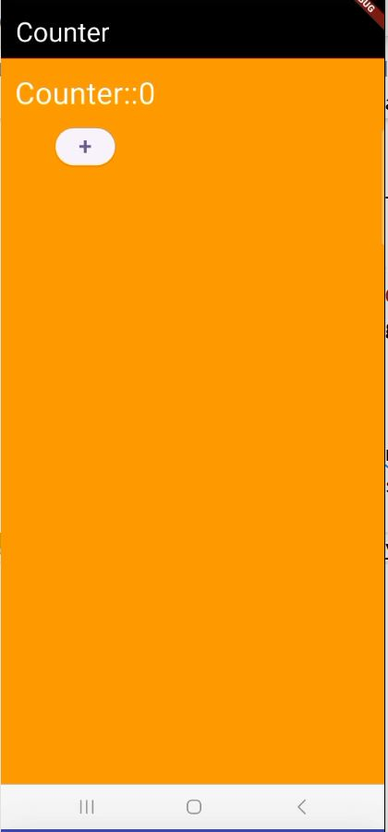
StatelessWidget
import 'package:flutter/material.dart';
class CounterExample extends StatelessWidget {
int _counter=0;
@override
Widget build(BuildContext context) {
return Scaffold(
backgroundColor: Colors.orange,
appBar: AppBar(title: Text('Counter',style: TextStyle(color: Colors.white),),backgroundColor: Colors.black,),
body: Padding(padding: EdgeInsets.all(15),
child: Column(
spacing: 10,
children: [
Text('Counter::${_counter}',style: TextStyle(fontSize: 25,color: Colors.white),),
ElevatedButton(onPressed: (){
_counter++;
}, child: Text('+',style: TextStyle(fontSize: 30),))
],
),
) ); } }

Slide 6
State Management

Slide 7
State Management
setState
BLoC (Business Logic Component)
Provider
GetX
Riverpod
Redux

Slide 8
StatefulWidget

Slide 9
StatefulWidget
class Counter extends StatefulWidget
{
State<StatefulWidget> createState() {
return _CounterState();
}
}
class _CounterState
{
Widget build(BuildContext context) {
}
}
extends State<Counter>

Slide 10
StatefulWidget
class CounterScreen extends StatefulWidget{
State<StatefulWidget> createState() =>_CounterScreenState();
}
class _CounterScreenState extends State<CounterScreen>
{
int _counter=0;
@override
Widget build(BuildContext context) {
return Scaffold(
body: Column(
children: [
Text('Counter::${_counter}',style: TextStyle(fontSize: 25),),
ElevatedButton(onPressed: (){
_counter++;
setState((){});
}, child: Text('+',style: TextStyle(fontSize: 30),))
],
)
);
}
}
Will call the build the method again and rebuild UI

Slide 11
Image
Asset Image
Network Image
Memory Image

Slide 12
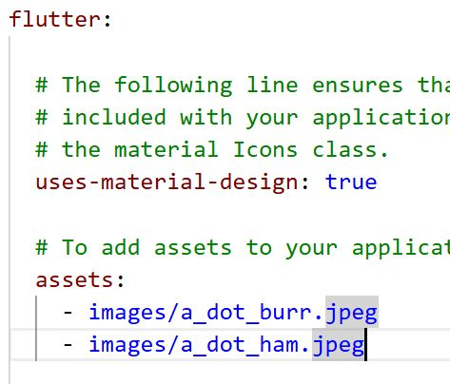
Asset Image
Create an Assets Folder: In the root directory of your Flutter project (the same level as pubspec.yaml), create a new folder, typically named assets. Inside this assets folder, you can create a subfolder, often named images, to organize your image files.
Add Image Files: Place your image files (e.g., .png, .jpg, .gif) into the assets/images subfolder.
Register Assets in pubspec.yaml: Open the pubspec.yaml file in the root of your project. Locate the flutter: section and uncomment or add the assets: subsection. You can specify individual image paths or include entire directories.

Slide 13
Image

